Slide 1

MTH403
MATHEMATICAL FOUNDATION FOR COMPUTER SCIENCE
#Zero Lecture

Slide 2
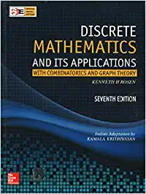
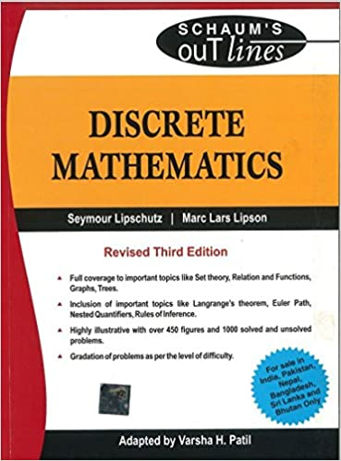
Books Required
Text Book:
DISCRETE MATHEMATICS & ITS APPLICATIONS by KENNETH H ROSEN, MCGRAW HILL EDUCATION
References Books:
DISCRETE MATHEMATICS (SCHAUM'S OUTLINES) (SIE) by SEYMOUR LIPSCHUTZ, MARC LIPSON, VARSHA H. PATIL, MCGRAW HILL EDUCATION

Slide 3
Course Objectives
Visualize formal logical arguments using propositional logic.
Discuss problem solving through the basics of combinatorics.
Apply the concepts of trees to find the shortest path.
Analyze basic discrete structures and algorithms
Discuss properties of graphs and be able to relate these to practical examples.
Evaluate theorems about trees, connectivity, coloring and planar graphs.

Slide 4
Course Assessment Model
Teaching Model:
L-T-P: 3-1-0 (3 Lectures, 1 Tutorial, 0 Practical)
Marks Breakup:
Attendance 5
CA (2 best out of 3 Subjective Tests) 30
MTE (MCQ) 25
ETE (MCQ) 40
Total 100

Slide 5
Syllabus Distribution: Unit-1
Mathematical Logic
Introduction to logic, propositions and compound propositions
Basic logical operations, Propositions and truth tables
Tautologies and contradiction, logical equivalence
Variables and quantifiers,
Redicate formulas, methods of proof

Slide 6
Unit-2
Ordered Sets, Lattices, Boolean algebra
Partially ordered sets, external elements of POSET
HASSE diagrams of POSETS, well-ordered sets
Lattices, bounded lattices, distributive lattices
Introduction to boolean algebra, basic definitions
Duality, basic theorems, boolean algebras as lattices

Slide 7
Unit-3
Techniques of Counting
Introduction, basic counting principles,
Mathematical functions
Permutations
Combinations
The pigeonhole principle

Slide 8
Unit-4
Graph Theory-I
Introduction and basic terminology
Graphs, Multigraphs, degree of a vertex
Handshaking theorem, sub graphs
Homeomorphic and Isomorphic graphs
Paths, connectivity, connected components,
Distance and diameter, Cut points and bridges
Eulerian graphs, Hamiltonian graphs

Slide 9
Unit-5
Graph Theory-II,
Euler theorem,
Planar graphs, maps, regions, Euler formula,
Non planar graphs, Kuratowski's theorem (without proof).
Graph coloring, chromatic number of a graph,
Labelled and weighted graph
Shortest path in weighted graphs
Dijkstra’s algorithm to find shortest path

Slide 10
Unit-6
Spanning tree and tree traversal,
Spanning tree, minimum spanning tree,
Kruskal and Prims algorithms to find minimum spanning tree
Binary search tree, infix,
Prefix, and post-fix notation,
Pre-order traversal, in-order traversal, and post-order traversal

Slide 11

Why to study logics and Proof ?
Computer programs are written in special, symbolic languages, e.g., Fortran, C++, Lisp, Prolog. These languages contain features of logical symbolism, and Lisp and Prolog are derived from formal languages for logic. Through such connections, the study of logic can help one in the design of programs.

Slide 12
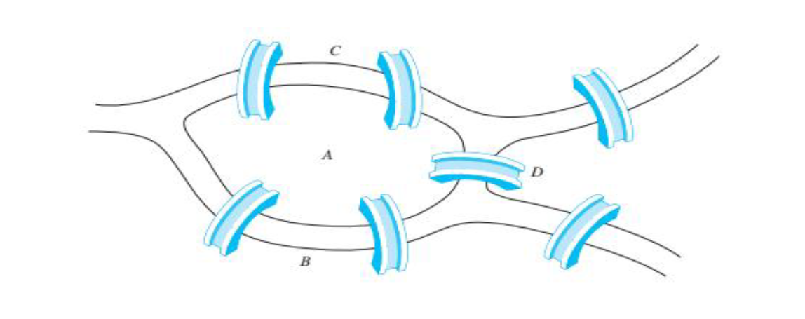
The Seven Bridges of Königsberg
Is it possible to start at some location in the town, travel across all the bridges once without crossing any bridge twice, and return to the starting point.

Slide 13
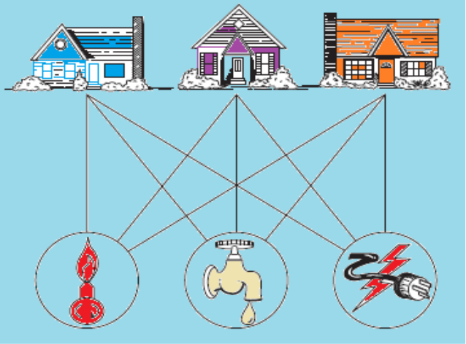
Application of graph theory
Consider the problem of joining three houses to each of three separate utilities, as shown in Figure .
Is it possible to join these houses and utilities so that none of the connections cross?
In this section we will study the question of whether a graph can be drawn in the plane
without edges crossing. In particular, we will answer the houses-and-utilities problem.

Slide 14
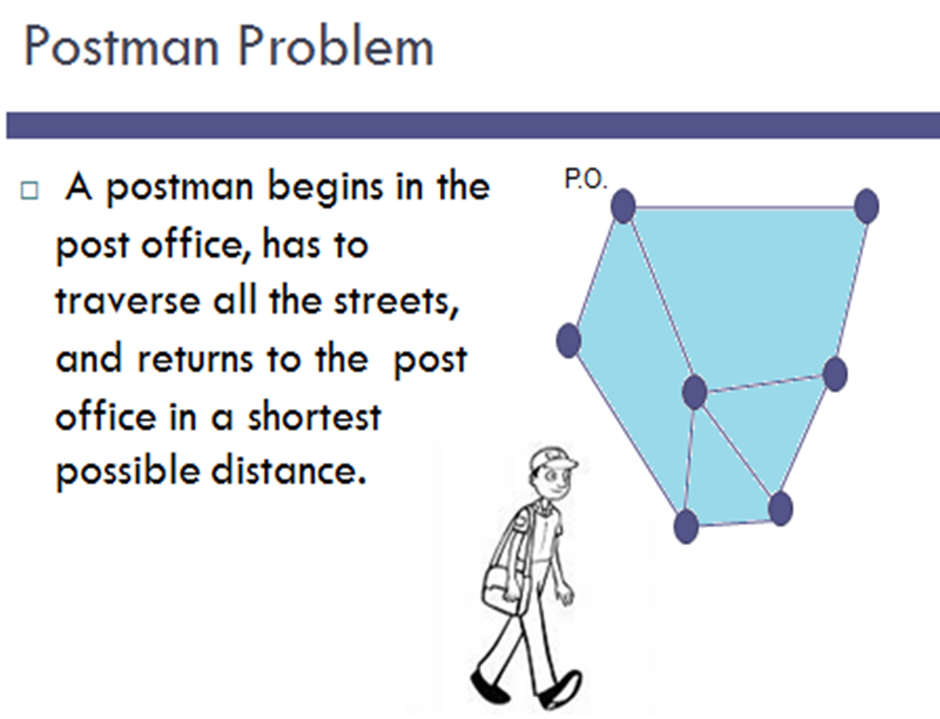

Slide 15
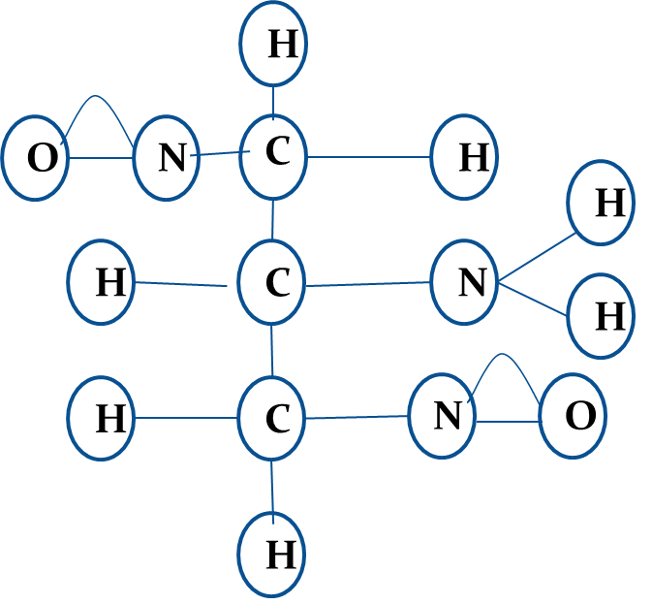
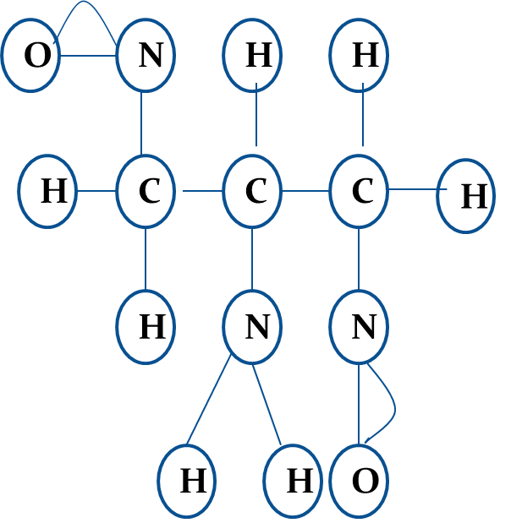


Determining if two compounds with the same formula are identical.

Slide 16
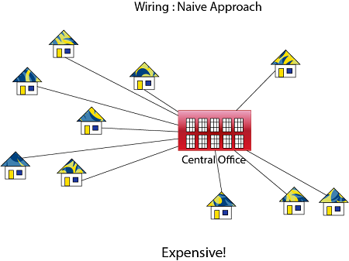
Application of Minimum Spanning Tree
Problem laying Telephone Wire

Slide 17
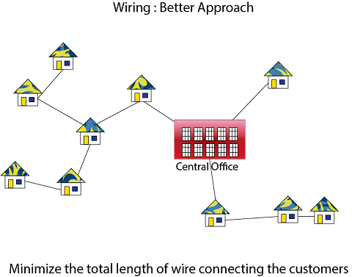

Slide 18

Assignment problem
There are 50 students in the class and teacher needs to prepare minimum number of class test for them in a way such that no two consecutive students get the same assignment.
It can be done via graph coloring , teacher can find chromatic no. of graphical representation of students

Slide 19
Next Class: Logic

Slide 20


